Slide 2
Python - The Basics
Dr. B. Malengier
DEPARTMENT OF MATERIALS, TEXTILES AND CHEMICAL ENGINEERING
CENTRE FOR TEXTILE SCIENCE AND ENGINEERING

Slide 3
Content
What is Python?
Local installation - Cloud use - Notebooks - Git - IDE
Language syntax ...
The power of libraries: the world at your fingers
Dive in !
Opdracht: Make a python code for Raspberry Pi

Slide 4
Why me?
Co-author of the application GRAMPS https://gramps-project.org/blog/features/
Co-author of odes https://scikits-odes.readthedocs.io/en/stable/
Years of experience, I can’t even remember when I started with Python programming!

Slide 5



Python - What is it?
Materials used from:

Slide 6
What is Python ?
A programming language
A way of life, … and coding.
Whatever you want it to be: calculator, scripting language, high end computing environment, and much, much more !

Slide 7
Users vs. Programmers
Users see computers as a set of tools - word processor, spreadsheet, map, todo list, etc.
Programmers learn the computer do things using a computer language
Programmers build new tools
Programmers write tools for lots of users, but sometimes they write little “helpers” for themselves to automate a task

Slide 8
What is Code? Software? A Program?
A sequence of stored instructions
> a little piece of our intelligence in the computer
> a little piece of our intelligence we can give to others - we figure something out and then we encode it and then give it to someone else to save them the time and energy of figuring it out
A piece of creative art - particularly when we do a good job on user experience

Slide 9
Why was Python made? Goals:
An easy and intuitive language just as powerful as major competitors
Open source, so anyone can contribute to its development
Code that is as understandable as plain English
Suitability for everyday tasks, allowing for short development times

Slide 10
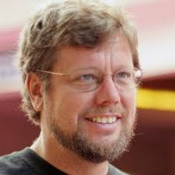
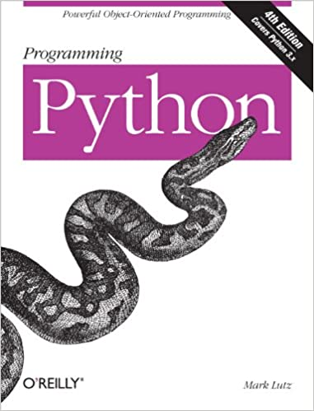
What is Python ?
Python is the language of the Python
Interpreter and those who can converse with
it. An individual who can speak Python is
known as a Pythonista. Nearly all known
Pythonistas use software initially developed
by Guido van Rossum.
Guido van Rossum was BDFL of Python.
Aside from guiding Python, he worked for Google and Dropbox on big software projects … written in Python.
He stepped down July 2018, and is now in pension.

Slide 11
Python Interpreter ?
Yes, an interpreter. You talk to it with commands, and it interprets your commands to take action.
How?
Interactive: You type directly to Python one line at a time and it responds.
Script: You enter a sequence of statements (lines) into a file using a text editor and tell Python to execute the statements in the file. Python files use the extension .py

Slide 12
Python is a Scripting Language
A programming language that is not compiled to byte code a computer processor understands, but is instead interpreted as commands are fed to it, is called a scripting language: Perl, PHP, Javascript, Python
However: if wanted, python allows you to create byte code to speed up interpreting. You can even compile if needed … but that is for an advanced course

Slide 13
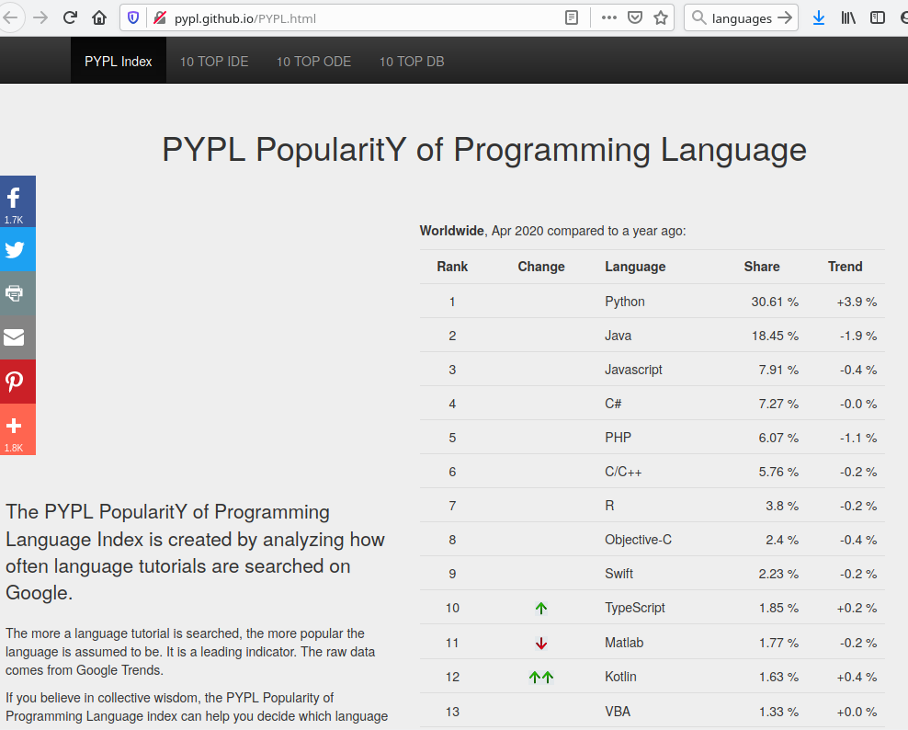
Why should I know Python ?
http://pypl.github.io/PYPL.html
Of April 2020:

Slide 14
Python - Setting it up
Materials used from:

Slide 15
What Python?
There are several versions of python …
Version Python 2.x will no longer be supported in 2021 ⇒ DON’T USE IT
Use version Python 3.5 or higher !
Careful, you want Python, not Jython (interpreter in Java), cython (compiled C version), or PyPy (JIT compiler)

Slide 16
Let’s start: local install
You need to install the Python Interpreter if you want to run python programs locally.
Better than we can explain:
https://realpython.com/installing-python/
However:
Consider full environments instead like https://www.anaconda.com/
Visual Studio Community https://visualstudio.microsoft.com/vs/features/python/

Slide 17
IDE?
Don’t forget to also install an IDE to program.
Pycharm: https://www.jetbrains.com/pycharm/
Eric: https://eric-ide.python-projects.org/
Spyder: https://www.spyder-ide.org/
Or the big boys like Eclipse, Visual Studio, ...

Slide 18
The Cloud
For basic course: Use python from your browser
First option: Interactive Notebook ! Used for courses.
https://colab.research.google.com/
Log in, and start a python notebook!
Alternative: https://cocalc.com/

Slide 19
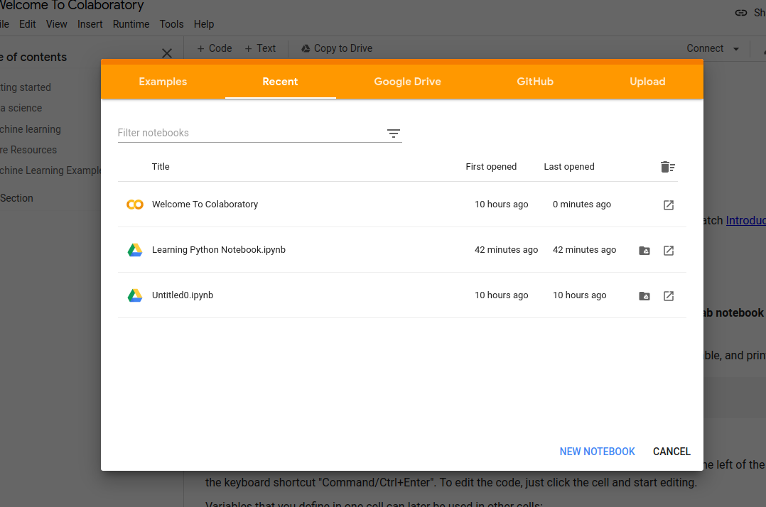
Create Notebook - Hello World
Select bottom right: New Notebook

Slide 20
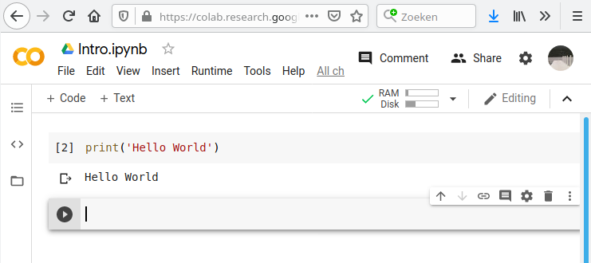
Give the notebook a name, eg Intro
Give text: print(‘Hello World’)
Press SHIFT+ENTER
YOUR FIRST PYTHON CODE !

Slide 21
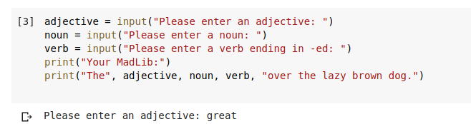
Excercise 1
From book Teach Your Kids To Code, page 33, copy the MadLib.py example in the Notebook, and execute it!

Slide 22
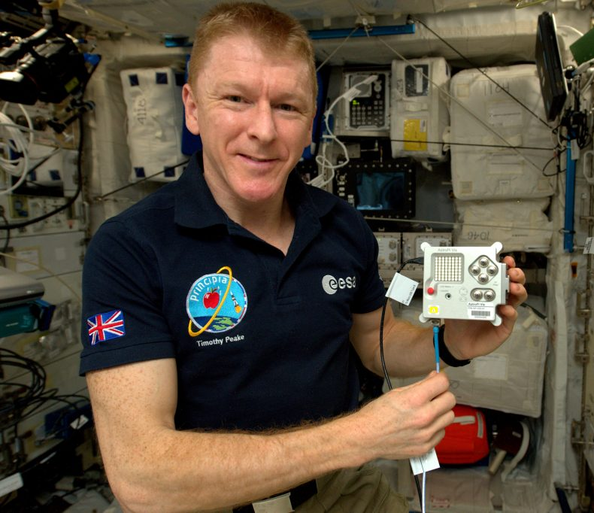
Great! Interactive works. Now, what about scripts ?
For simple examples:
Standard library: https://trinket.io/
Sense HAT on Raspberry Pi: https://trinket.io/mission-zero
BBC MicroBit using MicroPython (smaller version) https://create.withcode.uk/

Slide 23
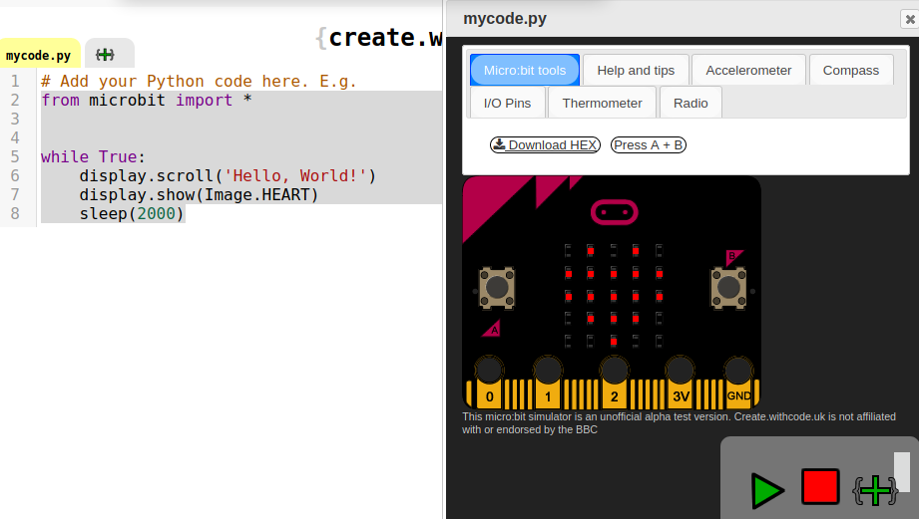
Exercise: Hello World on MicroBit
Paste following code in https://create.withcode.uk/
from microbit import *
while True:
display.scroll('Hello, World!')
display.show(Image.HEART)
sleep(2000)

Slide 24
Wait, what is that *, import, :, while, …. ????
You noticed the structure of the program?
Indentations are used and not curly brackets like { … }
Python is loved by orderly people because it forces you as much as possible to write orderly, readable, nice code.
Rossum 1999: "Computer Programming for Everybody"

Slide 25
The Zen of Python
There should be one-- and preferably only one --obvious way to do it.
In the notebook execute following code:
import this

Slide 26
Python - Language Syntax
Materials used from:

Slide 27
Example 01: Turtle - import - variable - for loop
In https://trinket.io/ run
import turtle
t = turtle.Turtle()
for x in range(100):
t.forward(x)
t.left(90)
We explain every line of code …
Exercise: Change the angle. Change the distance. Change the number of steps .
Notes:
Try this , very cool
import turtle
t = turtle.Turtle()
for x in range(100):
t.forward(x)
t.left(82.5)
t.backward(x)
t.right(45)

Slide 28
Example 02: Lists
import turtle
t = turtle.Turtle()
colors = ["red", "yellow", "blue", "green"]
for x in range(100):
t.pencolor(colors[x%4])
t.forward(x)
t.left(91)
Exercise: Go to https://docs.python.org/3.3/library/turtle.html?highlight=turtle
Look up what circle does, and use it.
Look up in function color how an RGB color can be defined, and use it!

Slide 29
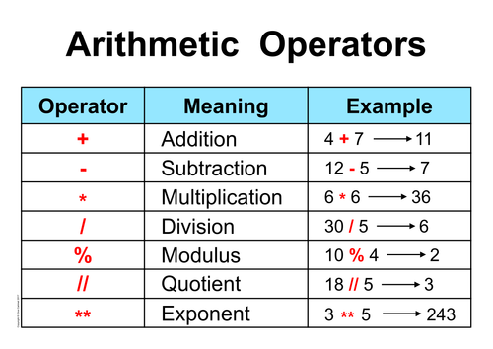
Example 03: Math - IF Condition
https://docs.python.org/3.3/library/math.html
https://docs.python.org/3.3/library/random.html

Slide 30
import turtle
import random
random.seed()
t = turtle.Turtle()
ts = turtle.getscreen()
ts.bgcolor("black")
colors = ["red", "yellow", "blue", "green"]
your_name = input("Enter your name", "What is your name?")
for x in range(80):
t.pencolor(colors[x%4])
t.fillcolor(colors[x%4])
if random.randint(0,1) == 1:
t.penup()
t.forward(x*4)
t.pendown()
t.write(your_name, font = ("Arial", int( (x + 4) / 4), "bold") )
t.left(90 + random.randint(0, 4))

Slide 31
Whitespace Rules
The key indentation rules laid out by PEP 8 are the following:
Use 4 consecutive spaces to indicate indentation.
Prefer spaces over tabs.
Usage:
Whitespace is meaningful in Python!
Use a newline to end a line of code
Use \ when must go to next line prematurely
No braces {} to mark blocks of code, use consistent indentation instead
First line with less indentation is outside of the block
First line with more indentation starts a nested block
Colons (:) start a new block in many constructs, e.g. function def, if-then clauses

Slide 32
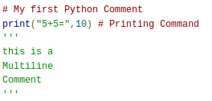
Comments
Use symbol # for commenting the lines
Multi-line comment starts with triple quotes ''' and ends with triple quotes '''
… they are multiline text not assigned to a variable!
Multi-line comments are used for the inbuild help. In Notebook, do: help(print)

Slide 33
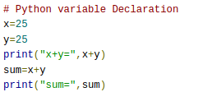
Variables : non Typed!
a container which is used to store values in a programs
no need to declare variables (is it an integer, a decimal number, text?) before using them
The Python Interpreter will identify the type of the variable and allocates space at run-time
In Notebook, do this, and do: type(sum). Change x in 25.8. Change x in 'a'. Result?

Slide 34
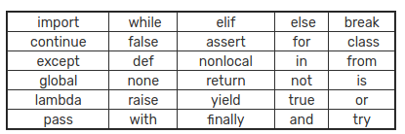
Rules for naming variables
The variable name can contain characters (both a-z and A-Z), underscore and digits (0-9). While naming any variable, we need to follow the following points:
A variable name can only start with any character or underscore. NOT number!
A variable name can contain digits.
A variable should not be a keyword:
It can be of any length.

Slide 35
Assigning a value
= is used to assign a value to a variable.
Multi-assign is allowed. Try:

Slide 36



Power of Python: Data Types
The varied number of data types creates many possibilities
Number data types:
Integer number
Float number
Complex number

Slide 37
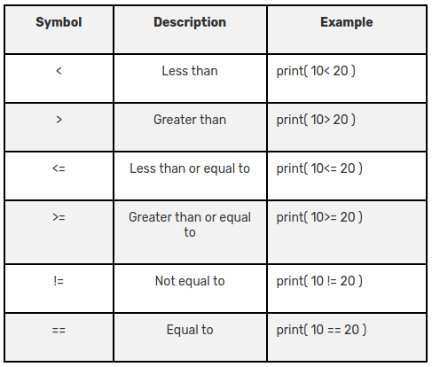
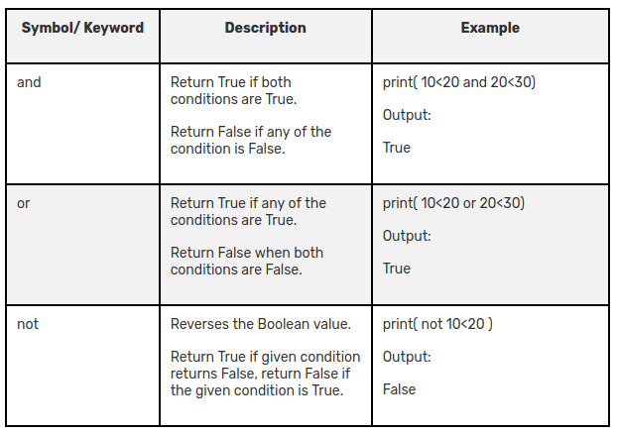
Data Types: Boolean
Boolean Data Type: True, False Note:
number 0 is False, others True
Empty string '' is False, others True
Result of conditional test.
Logical operators to compute with them

Slide 38
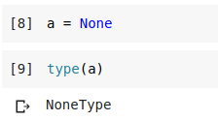
Data Types: None
None is a special data type in Python which represents an empty variable or absence of value.

Slide 39
Data Types: Sequence
Sequence data types:
String
List
Tuple
A sequence has an index referring to the elements. This starts with 0! A sequence has a length. A sequence element can be obtained with operator []. Slicing is possible: sequence[3:5]
A sequence has membership operators: in and not in

Slide 40
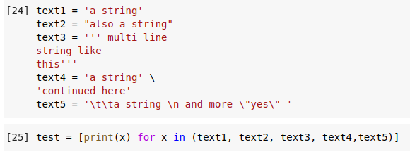
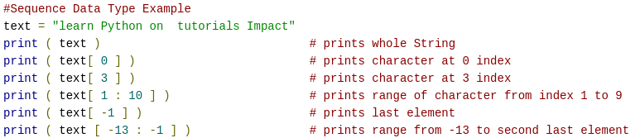
Data Type: String
More: https://docs.python.org/3.8/library/stdtypes.html#string-methods https://docs.python.org/3.8/library/string.html

Slide 41
Data Type: List
List is a sequence of values.
The values are enclosed in square brackets [ ].
The values are separated by commas [ 1, 2, 3 ].
Access each item of the list by using its index number. Lists can even contain another list as its element. Operations can be performed on Lists: Create, Update, Read, Delete

Slide 42
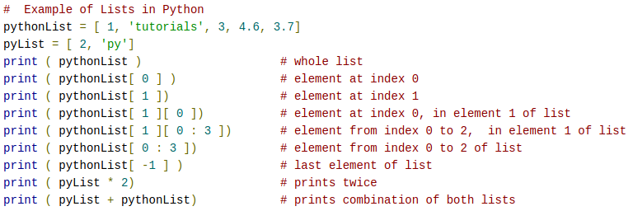
Data Type: List
More: https://docs.python.org/3.8/library/stdtypes.html#lists
https://docs.python.org/3.8/tutorial/datastructures.html

Slide 43
Data Type: Tuple
Tuple is exactly the same as the list.
BUT: we cannot change the size of the tuple.
Basically, when a tuple is declared once, it becomes read-only. We cannot update the tuple.
Declaration: use round brackets: ( )

Slide 44
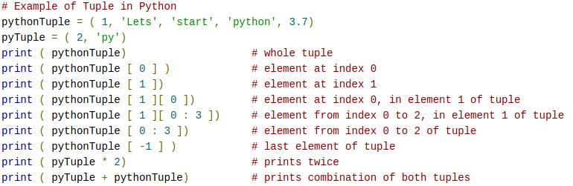
Data Type: Tuple

Slide 45

Data Types: Set
Sets is a collection in which we can store values of different data types.
It stores data in nonsequential order and we cannot access its data elements by indexing.
Sets are declared inside curly brackets { }.
Another special thing in sets is that duplicate entries are not allowed. It contains only unique data items.

Slide 46
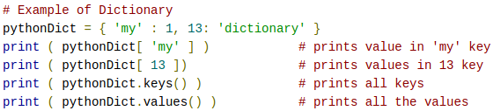
Data Types: Dictionary
Key, Value pairs
The keys in the dictionary should be unique.

Slide 47
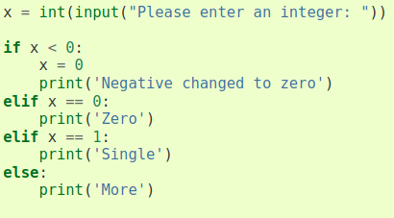
Control Flow: if elif else

Slide 48

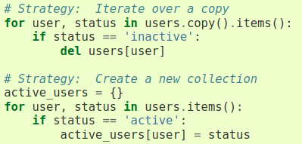
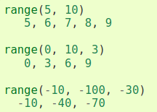

Control Flow: for loop
For loop loops over a sequence type
Range is often used in combination with for loop:

Slide 49
Control Flow: for loop - else, break and continue
Test:
for n in range(2, 10):
for x in range(2, n):
if n % x == 0:
print(n, 'equals', x, '*', n//x)
break
else:
# loop fell through without finding a factor
print(n, 'is a prime number')
And:
for num in range(2, 10):
if num % 2 == 0:
print("Found an even number", num)
continue
print("Found a number", num)

Slide 50
Control Flow: While loop
Do following loop:
# Fibonacci series:
# the sum of two elements defines the next
a, b = 0, 1
while a < 10:
print(a)
a, b = b, a+b

Slide 51
Defining functions
A function is created with def, for example:
def ask_ok(prompt, retries=4, reminder='Please try again!'):
while True:
ok = input(prompt)
if ok in ('y', 'ye', 'yes'):
return True
if ok in ('n', 'no', 'nop', 'nope'):
return False
retries = retries - 1
if retries < 0:
raise ValueError('invalid user response')
print(reminder)

Slide 52
Catching errors: try … except
You can catch errors being raised in a try block, by specifying the action that needs to happen in the except block. Example:
while True:
try:
x = int(input("Please enter a number: "))
break
except ValueError:
print("Oops! That was no valid number. Try again...")
Here, function int() raises an Error if not a number
More: https://docs.python.org/3/tutorial/errors.html

Slide 53
Object Oriented Programming: Classes
class MyClass:
"""A simple example class"""
students = None
def __init__(self):
self.students = ['John', 'Mary']
def add_student(self, name):
self.students.append(name)
def print_students(self):
for student in self.students:
print(student)
def number_of_students(self):
return len(self.students)
testclass = MyClass()
print(testclass.number_of_students())
testclass.add_student('Rose')
print(testclass.number_of_students())
testclass.print_students()

Slide 54
Python - Libraries
Materials used from:

Slide 55
Modules
Python has many standard modules allowing you to extend the functionality.
You import the namespace of the module using:
import modulename
Avoid importing everything, it makes debugging difficult
from modulename import *
You can import only what you need
from modulename import functioname, classname, variablename
You can make your own modules to structure code!

Slide 56
Standard Modules
These are present when you install python
https://docs.python.org/3.8/py-modindex.html
However: micropython reduces what is available. The BBC Microbit uses micropython

Slide 57
Third party modules
The power of Python is the high quality third party modules that extend the behavior.
They are collected in the PyPi index https://pypi.org/
… but many more are just personal projects on github
Anaconda gives an environment where packages are easy to install. In linux, packages are like normal software

Slide 58


Famous modules
Scipy https://www.scipy.org/
https://www.pygame.org/news
Tensor machine learning https://www.tensorflow.org/api_docs/python/tf
GUI programs: https://pygobject.readthedocs.io/en/latest/ or https://kivy.org/#home or like Cura 3D print software, Uranium an on top of PyQt: https://github.com/Ultimaker/Uranium https://github.com/Ultimaker/Cura

Slide 59
Python - Dive In !
Materials used from:

Slide 60
Sense HAT on Raspberry Pi
Go to https://trinket.io/mission-zero#
Make a sensible program, using the sense HAT
Save the program in your github account!
To make your program, use:
API sense_hat: https://pythonhosted.org/sense-hat/api/
Basic program: follow https://astro-pi.org/wp-content/uploads/2018/09/T05.2_Meet-the-Sense-HAT.pdf and adapt to your creativity. Also https://astro-pi.org/wp-content/uploads/2019/09/Astro_Pi_Mission_Zero_Project_Print_Out_2019_V4_PRINT.pdf
Advanced examples: https://github.com/astro-pi/python-sense-hat/blob/master/examples/README.md

Slide 61
Suggestions
Create random coloured dots on the screen as open screen
Create a short animation on the screen
Show temperature in a color scale

Slide 62
Python - References
Materials used from:

Slide 63
Stand on the shoulders of Giants
https://www.python.org/ https://docs.python.org/3.8/tutorial/
Rework of CC-BY slides of Copyright 2010- Charles R. Severance (www.dr-chuck.com) of the University of Michigan School of Information and open.umich.edu.
https://realpython.com
https://pynative.com/
https://tutorialsimpact.com/python/

